Slide 1
Vector multiplication
Presented by jamil rayhan
ID: 18cse061

Slide 2
What is vector multiplication?
Multiplication of two (or more) vector with themselves.
The product of the projection of the first vector onto the second vector
And the magnitude of the second vector.

Slide 3
Types of vector multiplication
There are two kinds of multiplication for vector.
Dot product
Cross product

Slide 4
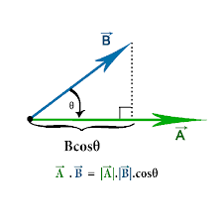
Dot Product
The dot product of two vector
A and B is defined as the scalar
value AB cosθ
Where θ is the angle between them such that 0≤θ≤π.

Slide 5
What is dot product?
It is denoted by A.B by placing a dot sign between the vectors.
So we have the equation,
A.B= AB cosθ
Another name of dot product is Scalar product

Slide 6
Illustration of dot product
If A and B are two vectors of form,
A = A₁i + A₂j +A₃k
B = B₁i + B₂j + B₃k
Then the dot product of A and B is,
A.B = A₁B₁ + A₂B₂ + A₃B₃

Slide 7
Example
If A = A₁i+A₂j+A₃k and B = B₁i+B₂j+B₃k,Prove that A.B = A₁B₁+A₂B₂+A₃B_{3.}
A.B =(A₁i+A₂j+A₃k ).(B₁i+B₂j+B₃k)
= A₁i.(B₁i+B₂j+B₃k) + A₂j.(B₁i+B₂j+B₃k) + A₃k.(B₁i+B₂j+B₃k)
= A₁B₁+A₂B₂+A₃B_{3.}
_{(Proved)}
i.i = j.j = k.k = 1 and all other product are zero

Slide 8
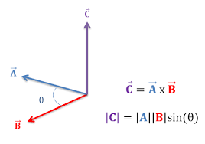
Cross product
The cross product of two vector A and B is defined as AB sinθ with a direction perpendicular to A and B in right hand system,
where θ is the angle between them such that 0≤θ≤π.

Slide 9
What is cross product?
Its denoted by A x B by placing a cross sign between the vectors.
So we have the equation,
A x B = AB sinθη = C
Another name of dot product is vector product

Slide 10
Illustration of cross product
If A and B are two vectors of form
A = A₁i + A₂j +A₃k
B = B₁i + B₂j + B₃k
Then the cross Product of A and B is,
A x B =
i j k
A₁ A₂ A₃
B₁ B₂ B₃

Slide 11
example
Find the cross product of a = (3,4,5) and b = (7,8,9)
The cross product is given as,
a × b =
= [(4×9)−(5×8)] i − [(3×9)−(5×7)]j + [(3×8)−(4×7)] k
= (36−40)i − (27−35)j + (24−28) k
= −4i + 8j −4k
i j k
3 4 5
7 8 9

Slide 12
Thank you

